Slide 1
Biological molecules
Year 11 Biology
Bremer SHS

Slide 2
Review
1. Name two organelles present only in plant cells.
2. Identify where in the cell is ATP generated.
3. Outline the main role of ribosomes.
4. Identify where genetic information is stored in the cell.
5. Explain the difference between a cell wall and a cell membrane.

Slide 3
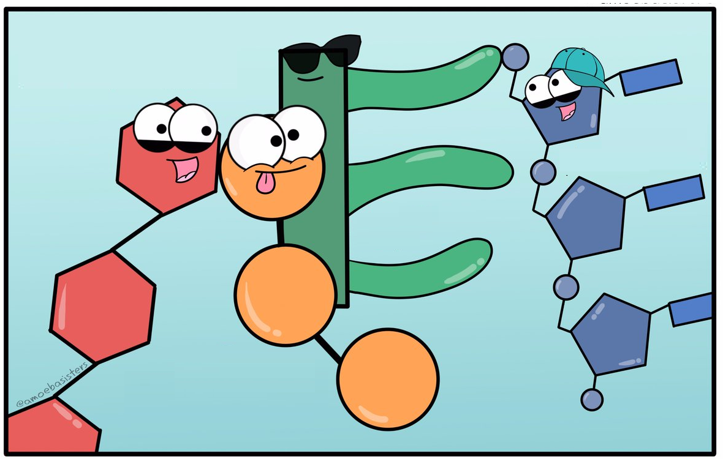
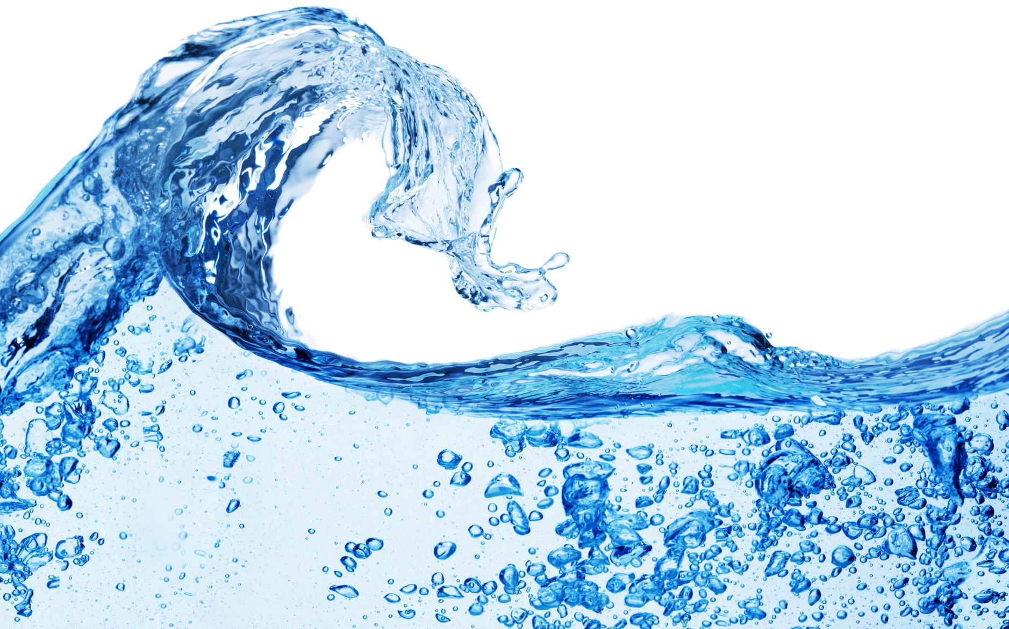
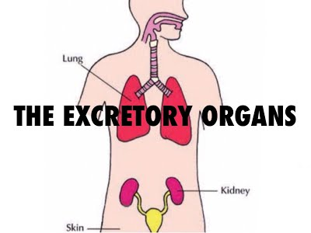
Anticipatory set
Molecules Necessary for Cellular Survival | Molecules Expelled as Waste

Slide 4

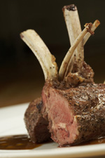
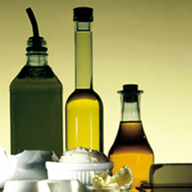
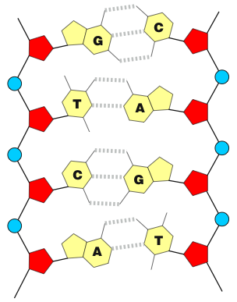
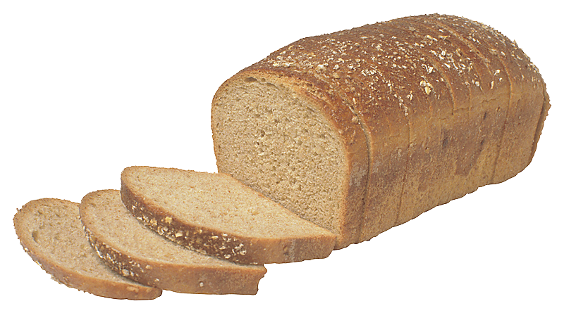
Types of biological molecules
The groups of molecules that make up all living things can be grouped in to five classes:
Water
Proteins
Lipids
Nucleic acids
Carbohydrates

Slide 5
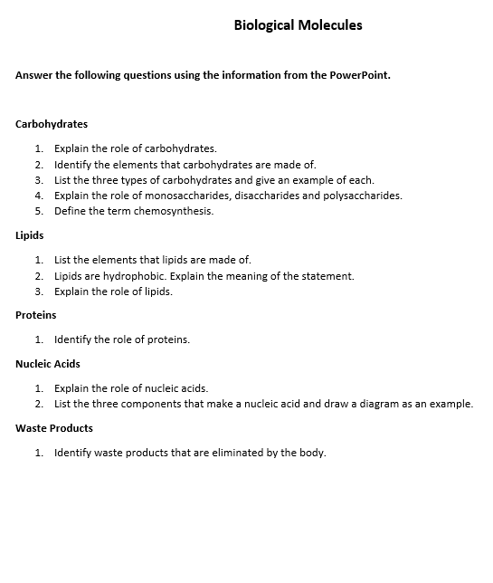
yOur job!
Use the information from this PowerPoint to complete the questions on the worksheet provided.

Slide 6
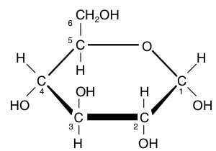
carbohydrates
Carbohydrates are a family of molecules made up of carbon, hydrogen, and oxygen atoms. Some are small, simple molecules, while others form long polymers. Carbohydrates have the general formula (CH2O)x
Carbohydrates are important as both energy storage molecules and as the structural elements in cells and tissues.
Monosaccharides, Disaccharides and polysaccharides are carbohydrates.
6
Glucose
4
1

Slide 7
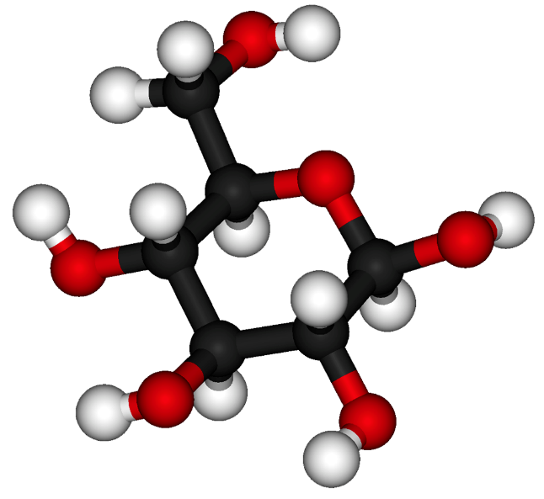
Monosaccharides
Monosaccharides are used as a primary energy source for fueling cellular metabolism.
Monosaccharides are single-sugar molecules. They include:
glucose (grape sugar and blood sugar).
fructose (honey and fruit juices).
Glucose is a monosaccharide sugar.

Slide 8
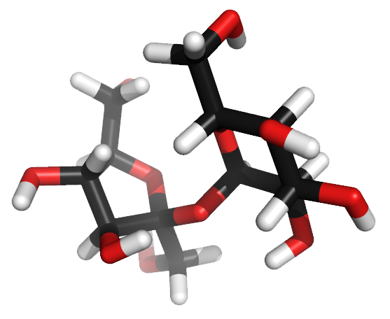
Disaccharides
Disaccharides are double-sugar molecules bonded together.
They are used as energy sources and as building blocks for larger molecules.
Disaccharides provide a convenient way to transport glucose.
Sucrose, lactose and maltose are examples of disaccharides.
A sucrose molecule (above) depicted as a stick molecule.

Slide 9
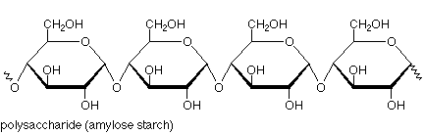
Polysaccharides
Polysaccharides are polymeric carbohydrate molecules composed of long chains of monosaccharide units. Polysaccharide examples include;
Glycogen is used for energy storage in animals
Starch is used for energy storage in plants
Cellulose is used for structural support in plants (cell wall)
Chitin makes up the hard exoskeleton of insects
Starch

Slide 10
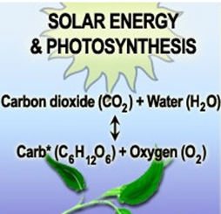
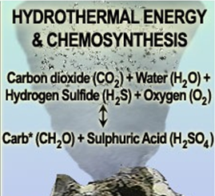
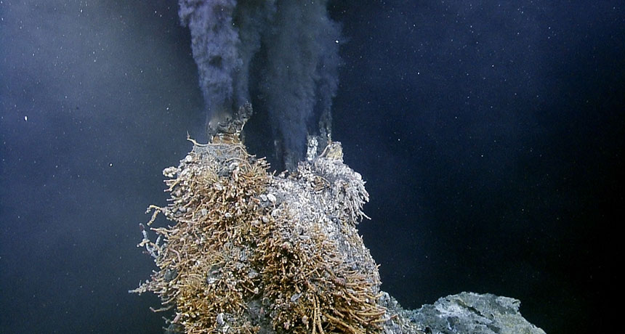
No sunlight = no problem
If a cell cannot produce a carbohydrate source directly through photosynthesis, or rely on it may have to rely on chemosynthesis.
Chemosynthesis is the process by which a carbohydrate source is made by bacteria using chemicals as the energy source, rather than sunlight.
Chemosynthesis occurs around hydrothermal vents and methane seeps in the deep sea where sunlight is absent.
Deep sea hydrothermal vent teeming with life.

Slide 11
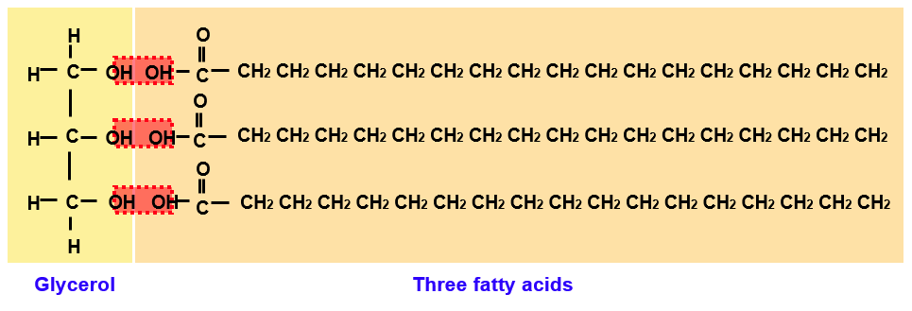
Lipids
Lipids are a group of organic compounds with an oily, greasy, or waxy consistency.
Like carbohydrates, lipids contain carbon, hydrogen, and oxygen, but in lipids, the proportion of oxygen is much smaller.
They are relatively insoluble in water and tend to be hydrophobic.
Typical lipids consist of fatty acids and glycerol.

Slide 12
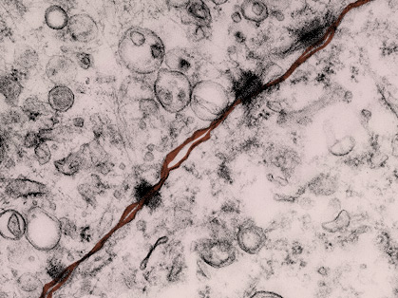
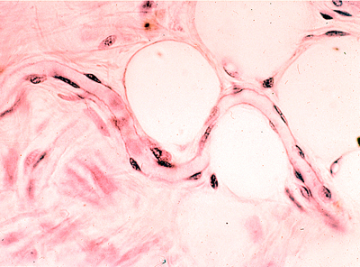
Lipids
Lipids can be classified as simple lipids (fats, oils, and waxes), phospholipids and steroids.
Lipids have many roles, including as:
biological fuels
hormones
structural components of membranes
Fats provide twice as much energy as carbohydrates.
Proteins and carbohydrates can be converted into fats stored in adipose tissue.
Plasma membrane
Phospholipids are the primary structural component of all cellular membranes, such as the plasma membrane (false color TEM above).
Fat cell
Capillary
Lipids are often stored in special adipose tissue, within large fat cells (above).

Slide 13
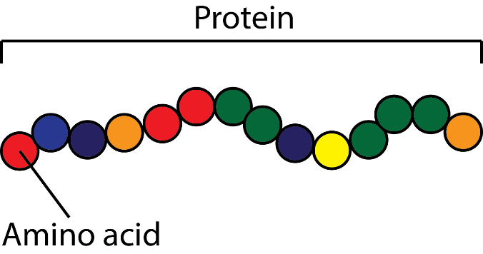
Proteins
Proteins are macromolecules, consisting of many amino acids linked together as polypeptide chains.
Proteins play a key role in the body. They are involved in:
Enzyme reactions
Oxidation-reductions, e.g. respiratory chain
Structure (eg. collagen)
Storage (eg. ferratin stores iron)
Transport (haemoglobin)
Cell signaling (hormones)
Defense (antibodies)
Energy production

Slide 14
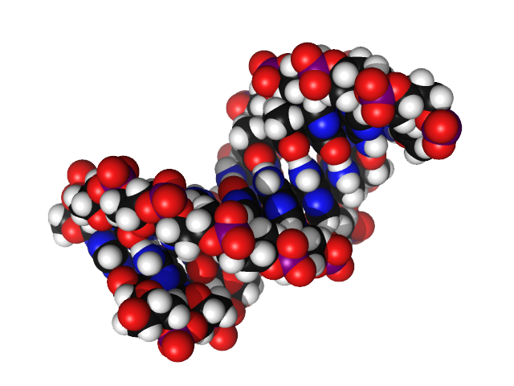
Nucleic Acids
Nucleic acids are biochemical macromolecules involved with the transmission of inherited information.
There are two main types of nucleic acids involved with inheritance:
Deoxyribonucleic acid (DNA)
Ribonucleic acid (RNA)
Nucleic acids are made up of many units called nucleotides.
DNA (space filling model right) is the most commonly occurring nucleic acid.

Slide 15
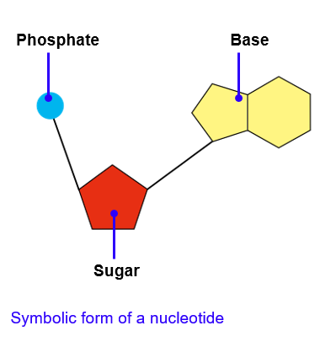
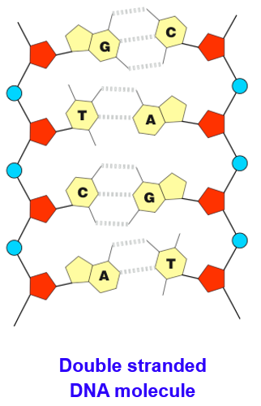
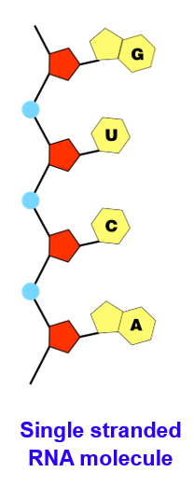
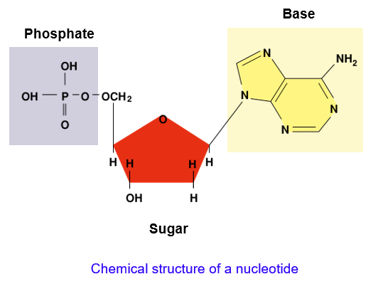
nucleotides

Slide 16
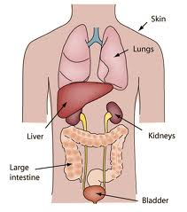
Waste products
Carbon dioxide and hydrocarbonate ions produced in cellular respiration.
Ammonia produced by gut bacteria during the breakdown of protein.
Urea produced to lower the level of toxic ammonia.
Uric acid produced in the breakdown of purines found in some foods.
The liver contains molecules which quickly convert toxic ammonia (and carbon dioxide) into urea.

Slide 17
Check for understanding
What would happen to a person who does not eat enough protein in their diet?
The gallbladder stores bile produced by the liver that is used to break down fat in the food that we eat.
If a patient has their gallbladder removed surgically, outline how will it effect the digestion of macromolecules?
What impact will having their gall bladder removed have on the patient physically?
Suggest a potential diet for the patient.

